Slide 1
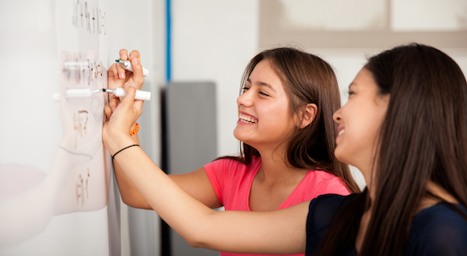
Problem Solving Session
The remainder of today’s class will comprise the problem solving session (PSS).
Your instructor will divide you into teams of 3 or 4 students.
Each team will work together to solve the following problems over the course of 20-30 minutes.
Your instructor will go over the solution before the end of class.

Slide 2

Problem Solving Team Members
Record the name of each of your problem solving team members here.
Do not forget to add every team member’s name! Your instructor (or course assistant) may or may not use this to determine whether or not you participated in the problem solving session.

Slide 3
Problem Solving 1
User Enters | Expected Output
"1"
"12.34"
"abc"
"-1"
"ab"
Given the code below, write the expected output for each of the inputs to the right.
def crazy_output():
x = input("Type something: ")
try:
int_x = int(x)
print("You entered an integer:",
int_x)
except ValueError:
try:
float_x = float(x)
print("You entered a float:",
float_x)
except:
print("The third character is:",
x[2])

